Slide 1
Microsoft Windows Thread States
Ref: Stallings “Operating Systems”, Ed. 6

Slide 2
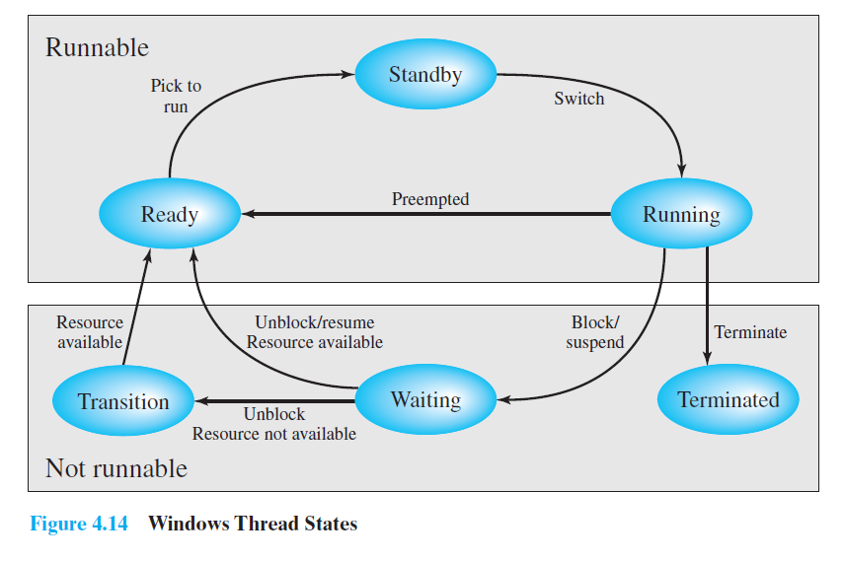
Microsoft Windows Thread States
Ref: Stallings “Operating Systems”, Ed. 6

